Slide 1
Catalog Form Submissions Using OneDrive
Office of the Provost and Vice Chancellor for Academic Affairs

Slide 2
Learning Outcomes
At the end of the presentation, you will be able to:
Successfully access OneDrive
Navigate unit folders and upload documents
Gain a working knowledge of the catalog form process, including corrections for common errors
Access and the catalog form tracking document

Slide 3
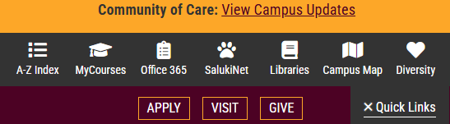
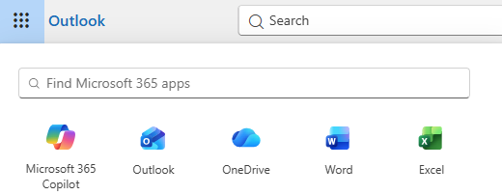
Accessing OneDrive – 3 Steps
Open SIU.edu, select Quick Links, and click on Office 365
Log in using your DawgTag and password
Click the App Launcher grid and select OneDrive

Slide 4
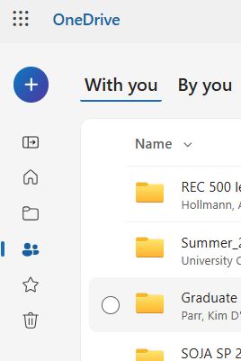
Accessing OneDrive (continued)
4. Select “Shared” to open the files and folders other users have shared with you.

Slide 5
Banner Codes – Colleges and Schools
Unit Name | Banner Code
College of Agricultural, Life, and Physical Sciences | AL
College of Arts and Media | AM
College of Business and Analytics | BY
College of Engineering, Computing, Technology, and Mathematics | ER
College of Health and Human Sciences | HH
College of Liberal Arts | LA
School of Education | EE
Simmons School of Law | LW
School of Medicine | MD

Slide 6
College/School Folders
College/School folders are titled “Forms 90 and 90A – [Banner code for College/School]”
You will only have access to your College’s/School’s folder
Access has been given to Associate Deans, School Directors, and primary support staff. Additional access can be requested by emailing APAP@siu.edu.
Form 100s can also be submitted using these folder. Please do not submit RMEs via the OneDrive folder – these should be sent to APAP@siu.edu.

Slide 7
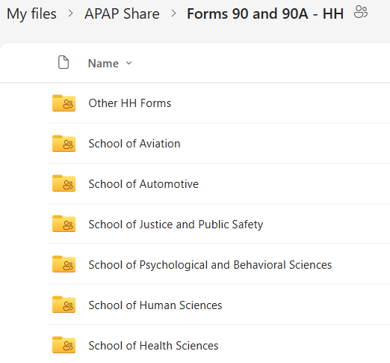
College/School Folders (continued)
College folders contain sub-folders for schools, along with blank forms for the 2027-28 catalog cycle.

Slide 8
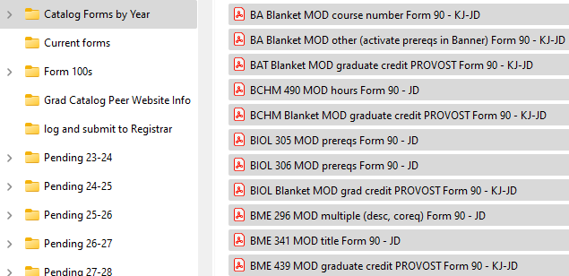
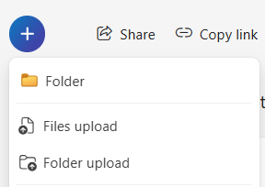
File Submission
Two options for submitting files:
Drag and drop files from your computer (File Explorer)
Click on the circle with a “+” sign and select “Files upload” to select the files to upload
OR
Upload completed forms to the appropriate school sub-folder. Additional sub-folders can be added if necessary.

Slide 9
File Submission, continued
RME Status.xlsx
RME Status.xlsx
How do I know my files were received?
  A tracking log that shows the status of all catalog documents is available on the Provost’s website. This will be updated as forms progress through the approval process.
  The tracking log can be accessed from the Provost’s website:
  https://provost.siu.edu/academic-programs/index.php#catalog
  Or directly from here: Form 90/90As Tracking Log 2027-28
  * Note: you may need to log in to OneDrive with your network ID and password when you click on the link to the tracking sheet

Slide 10
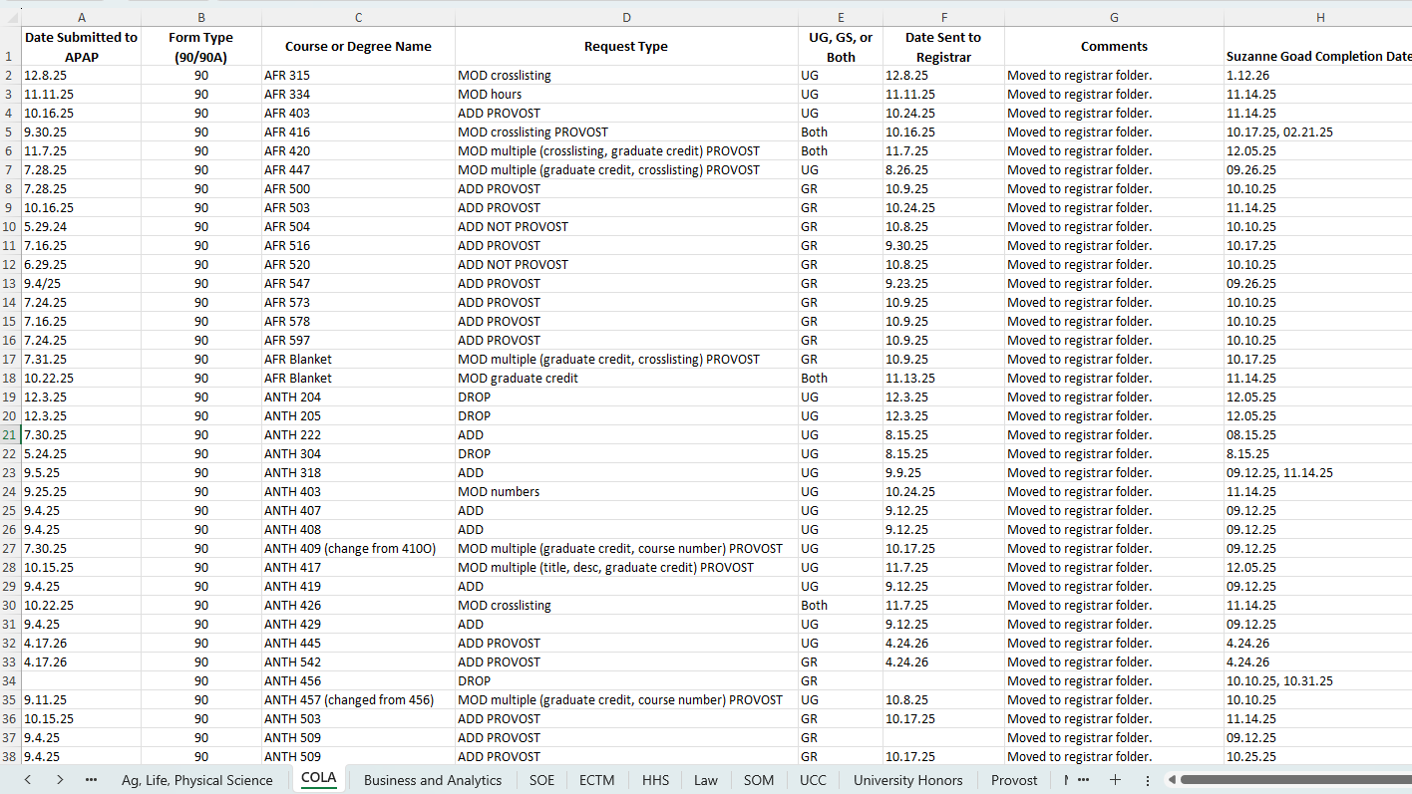
APAP Catalog Tracking Log
Column Content:
Received Date
Form Type
Course or Program to be edited
Description of Request
Catalog to be edited
Date submitted to Registrar
Comments by APAP staff or Registrar staff
Form 90 Completion Date
* Note: Separate Worksheets for each College

Slide 11
APAP Catalog Tracking Log Overview
The tracking log is titled ‘Form 90/90As Tracking Log 2027-28’
The spreadsheet will be updated regularly.
Will provide transparency into the processing timeline and show completion dates for Form 90s.
Use to confirm that APAP received your documents and if they’ve been approved and submitted to the Registrar’s office.
  Should eliminate redundant submissions.
  Provide at-a-glance tracking to all colleges.
If your college submitted forms that are not listed on the spreadsheet, please contact APAP@siu.edu.

Slide 12
Filename Conventions
The APAP Office uses the following naming conventions for catalog forms:
Form 90
  Form 90 filenames include the course prefix/number and the action requested in ALL CAPS, followed by the file type.
  For example:
  ECFS 250 ADD Form 90
  MHI 525 MOD hours Form 90
Form 90A
  Form 90A filenames include the file type, then the college/school Banner code, degree type, and the program abbreviation separated by underscores.
  For example:
  90A LA_BS_LCIS
  90A ER_MS_CS

Slide 13
Submission Deadlines
Submission deadline is October 1st.
APAP staff will monitor all folders closely during the submission cycle, which is mid-August to October 1st.
If you have time-sensitive forms – Form 90s that need to be processed in Banner for an early effective term – notify us at APAP@siu.edu.

Slide 14
Tips and Helpful Insights
Forms must be complete when submitted, including all necessary unit signatures.
Forms will be accepted via email to APAP@siu.edu, but we prefer file submission through OneDrive.
‘Blanket Form 90s’ can be submitted if the same change is applied to multiple courses, such as a prefix change.
APAP office will facilitate supplementary signatures, including UCC Director, Honors Director, and Graduate School Associate Dean and Director.
Please ensure that requested changes are clearly marked and forms are filled out completely.

Slide 15
Common Form Errors
Missing signatures – all unit-level signatures (school/college) should be complete before submitting to APAP.
Support staff CANNOT sign ‘on behalf of’ anyone for catalog forms.
Missing syllabi – required when adding new courses. Do not include instructor names.
Graduate Credit – you must check yes or no. This prompts APAP staff to submit form for signature.
Degree Attribute – mark if a course is UHON or UCC. This prompts APAP staff to submit form for signature.
Co-Requisite or Crosslisted courses – these courses must be listed on the Form 90. Accompanying Form 90s for these courses are required to ensure continuity.
  If additional Form 90s are needed outside your program/school/college, please contact the appropriate director or dean to advise that Form 90s are necessary. Include a copy of your Form 90 and any supporting documentation for their reference.
  All Form 90s pending additional documentation are placed on hold until that documentation is received.

Slide 16
Common Form Errors (continued)
When DROPPING a course – if it is a pre-requisite for another course, a Form 90 is needed for that course to remove it as a pre-requisite.
When DROPPING a course – remember that you need to remove it from your catalog page via a Form 90A. A Form 90A is necessary for every program’s catalog page where that course appears.
The same is true when renaming a course – every program’s catalog page must be updated via a Form 90A.
  For example - AD prefix changed to ARTH for Art History courses:
    Form 90s submitted to change course names. (Blanket Form 90 appropriate here.)
    Form 90A submitted to update catalog pages where the new ARTH courses are listed in program requirements.

Slide 17
Questions?
Contact the APAP Office
APAP@siu.edu
453-7653

