Slide 1
Program/Center Reviews
Office of the Provost and Vice Chancellor for Academic Affairs
Notes:
NACADA: The Global Community for Academic Advising

Slide 2
Overview
IBHE requirements for program review
Process for program review
State of Illinois policy governing conflict of interest on program reviewer nominations
Overview of self-study
Resources available through APAP website

Slide 3
IBHE Requirement for a Review
IBHE requires a review of each degree program on an eight-year cycle
https://www.ibhe.org/assets/files/ProgramReviewGuidelines.pdf
Exceptions to this requirement are new programs, which are reviewed three years after approval
Degree-specific accreditations meet the requirement of the IBHE-mandated review provided that they are reviewed at least every eight years

Slide 4
Overview of Process
Start
Self Study
Select Internal Reviewers
Internal Review
Reviewers’ Report
Dean’s Report
IBHE Report
Submit Names of Internal Reviewers Spring Semester
Self Study is due to APAP by August 15th
Internal Review by End of Fall Semester

Slide 5
Timeline for Program/Center/Institute Review
Submit Reviewers Names to APAP: May 15
Submit Self-Study Report to APAP: August 15
Submit Self-Study Report to Reviewers: September
Schedule Meetings: September - November
Reviewer’s Report Due: First week of December
Meeting to discuss Results: December - February
Dean’s Report Due: February
APAP Office compiles all review reports and submit to System’s Office: Summer

Slide 6
Selection of Reviewers
Programs/Centers/Institutes submit nominations of internal reviewers to the APAP office. The nominations are approved by Faculty Senate (UG programs) and Graduate Council (Program Review Committee).
Please discuss with the APAP office if you think you might need more than one external reviewer.
According to the State Officials and Employees Ethics Act (5 ILCS 430/), units must avoid nominating reviewers with potential bias or conflicts of interest with the program or its faculty.
Reviewers should not be current or former collaborators, colleagues, mentors, and students, faculty and staff of unit or past reviewers of the unit.
If you have any questions about possible conflicts of interest, contact the APAP (453-7653).

Slide 7
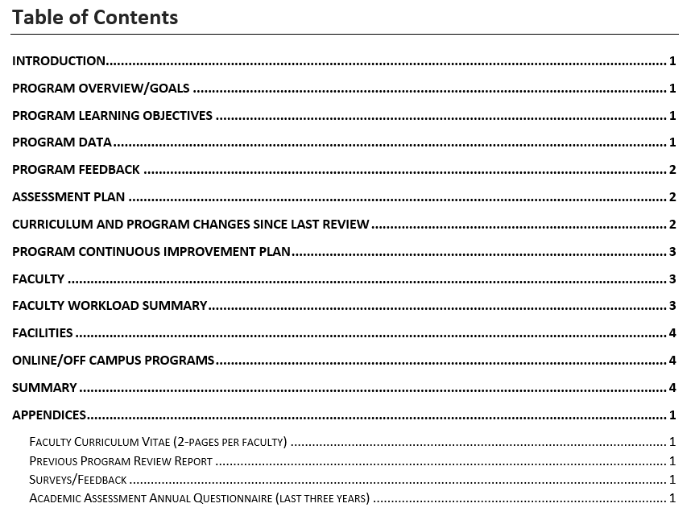
Writing the Self-Study: Program Review
Assessment Plan
Assessment Report
Self-Study
Notes:
Credit to Dr. Rich Robbins for “Co-Curricular Audit”

Slide 8
Writing the Self-Study: Program Review
Online/Off-Campus Programs
Optional section for programs that have degree programs offered online and/or off-campus. At a minimum, address the following questions:
Are student learning outcomes the same across modalities (online/off-campus)? Does the assessment process include evaluation of data and continuous improvement plans for all modalities?
If NTT faculty teach in the online and/or off-campus program, what is the process for determining faculty qualifications?
Is student advisement for online/off-campus students adequate?
What resources are available to online/off-campus students?
How are laboratory components offered (if applicable)? Are similar laboratory experiences, facilities, and classrooms provided to online and off-campus students?

Slide 9
Writing the Self-Study: Program Review
Summary
Describe the program’s plan for future growth and improvement in the next eight years.
Curricular, research, facilities, faculty recruitment and development, student recruitment and retention, diversity goals.
What opportunities exist to extend and build on the present strengths? What are the major obstacles?

Slide 10
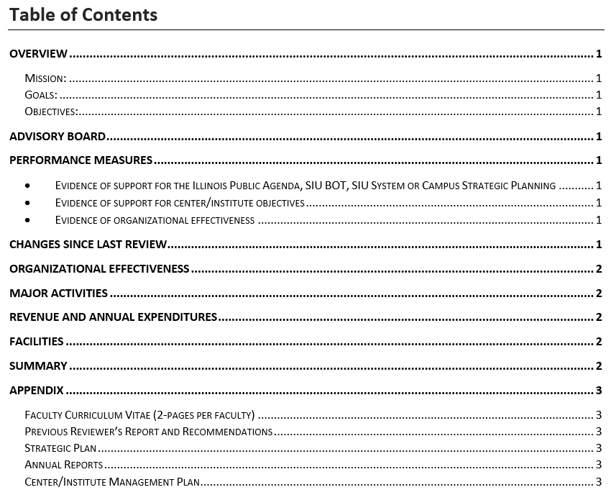
Writing the Self-Study: Center/Institute Review
Centers and Institutes are required to submit an annual report to the OVCR
Annual
Reports
Self-Study
Notes:
Credit to Dr. Rich Robbins for “Co-Curricular Audit”

Slide 11
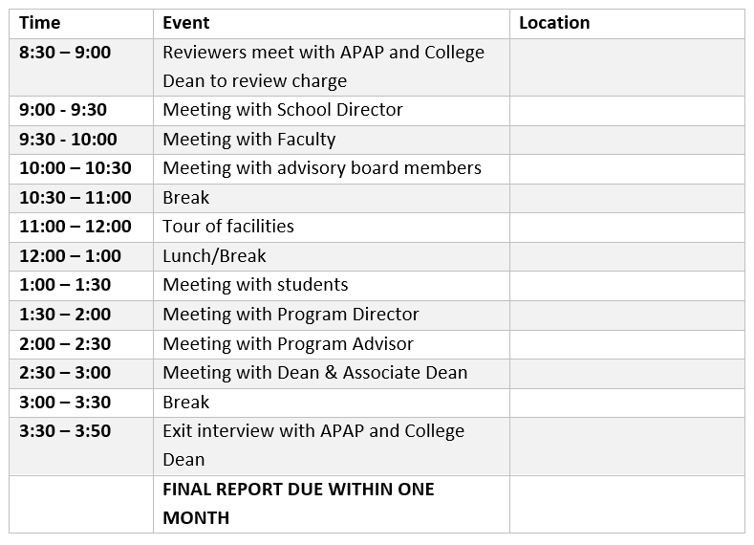
Site Visit Itinerary
The program administrative unit is responsible for developing the itinerary. Meetings should be scheduled with:
APAP (charge meeting)
Dean of College
Faculty
Students
Advisory Board Members (if applicable)
Include time for reviewers to tour facilities

Slide 12
Site Visit
The purpose of the on-site review is to verify the evidence provided in the self-study. This is primarily done through interviews with a range of constituencies:
Faculty
Students
Provost
Dean
Vice Chancellor for Research
Advisory board
Collaborative or support programs
Tours of facilities (for virtual reviews: virtual, videos, labelled pictures)

Slide 13
Reviewers’ Report: Programs
Overview
Unique or innovative approaches to teaching, learning, or new knowledge creation
Program Assessment
Faculty involvement in and awareness of the contents of the self-study
Faculty involvement with the development of program goals, program learning outcomes (PLOs) and student learning outcomes (SLO).
Involvement of internal or external constituencies other than faculty in developing program goals, PLOs and SLOs.
Development of appropriate assessment tools and benchmarks for determining if SLOs are being met.
Alignment of SLOs and PLOs.
Involvement of key stakeholders in reviewing assessment results.
Evidence that assessment and other feedback is used for continuous improvement.
Actions Taken Since Last Review
Online/off campus programs
Classrooms, Facilities, and Laboratories
Leadership and Institutional Support
Recommendations

Slide 14
Reviewers’ Report: Centers/Institutes
Overview
Performance Measures
How is Advisory Board or other constituencies involved in defining and reviewing mission, goals, and objectives?
Are performance measures appropriate for determining the achievement of center/institutes mission, goals, or objectives?
How is the center/institute documenting evidence of continuous improvement?
Facilities and Laboratories
Leadership and Institutional Support
Recommendations

Slide 15
Third-Year Program Progress Report
As part of the NUI, a plan to assess and improve student learning is required. The following information is included:
List of the program’s student learning objectives (outcomes)
Describe how, when, and where the learning objectives (outcomes) will be assessed
Identify faculty expectations for students’ achievement of each of the stated student learning objectives (outcomes)
Explain the process that will be implemented to ensure that assessment results are used to improve student learning
Report elements:
Provide a summary report of the progress to date for the items above.
Assessment plan and most recent assessment reports.

Slide 16
Program Review Report (IBHE Requirements)
5.1 Description and assessment of any major changes in the program [e.g., (a) changes in the overall discipline or field; (b) student demand; (c) societal need; (d) institutional context for offering the degree; (e) other elements appropriate to the discipline in question; and (f) other].
5.2 Description of major findings and recommendations, including evidence of learning outcomes and identification of opportunities for program improvement;
5.3 Description of actions taken since the last review, including instructional resources and practices, and curricular changes; and
5.4 Description of actions to be taken as a result of this review, including instructional resource and practices, and curricular changes.

Slide 17
Final Campus Report
APAP
SIU Systems Office
IBHE
SIU System Program Quality Assurance Report https://siusystem.edu/innovation-planning-partnerships/reports/index.shtml

Slide 18
Online Resources – APAP Website
Academic Assessment Annual Questionnaire
Program Resources
Self-Study Template
Itinerary Template
Suggested Guidelines for Faculty CV (short form)
Reviewer Resources
Sample Reviewer Questions
Reviewer Report Template
Dean Resources
IBHE Program Review Form
Tutorials
https://pvcaa.siu.edu/associate-academic-programs/program-review/
Office of Associate Provost for Academic Programs 453-7653 apap@siu.edu

Slide 19
THANK YOU!

