Slide 1
Program and Catalog Changes
Office of the Provost and Vice Chancellor for Academic Affairs
Notes:
NACADA: The Global Community for Academic Advising

Slide 2
Program Description (Form 90A)

Slide 3
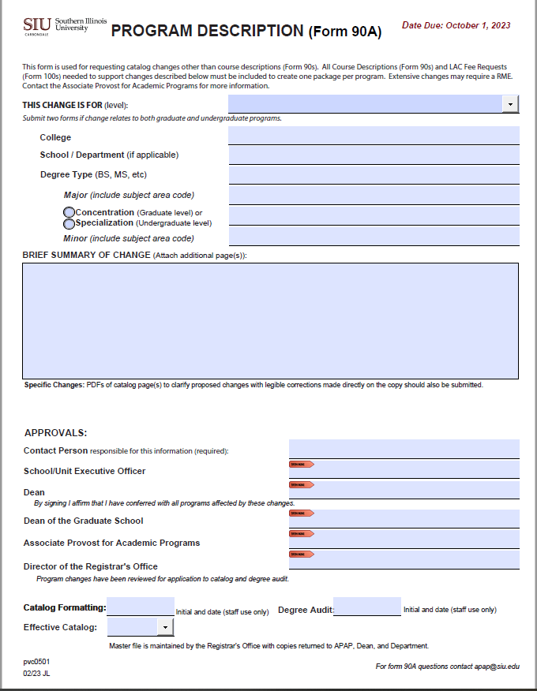
Program Description (Form 90A)
The Program Description (Form 90A) is used to change requirements of any academic program.
The Form 90A is used to edit:
Catalog text (program catalog copy)
Outline academic degree requirements
Used to build Degree Works
Faculty listing

Slide 4
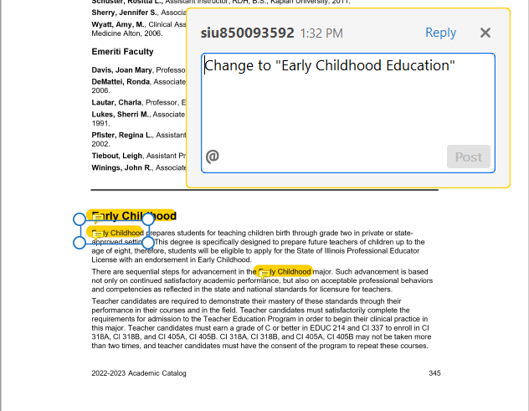
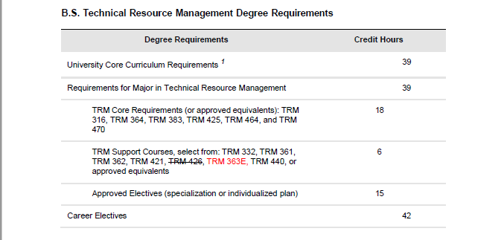
Form 90A and RME
Modify a Program’s Degree Requirements – Form 90A
Rename a Program – RME Approval

Slide 5
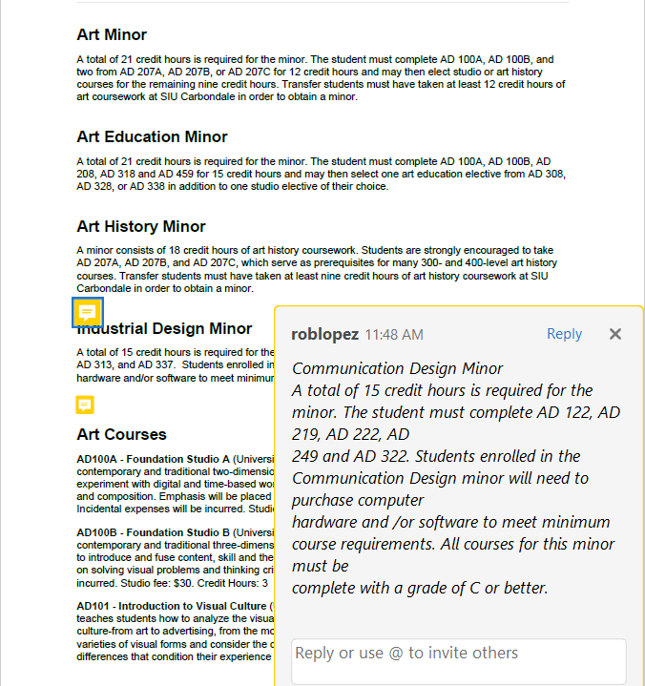
Form 90A and RME
Add a Minor – RME Approval
Rename a Minor – RME Approval

Slide 6
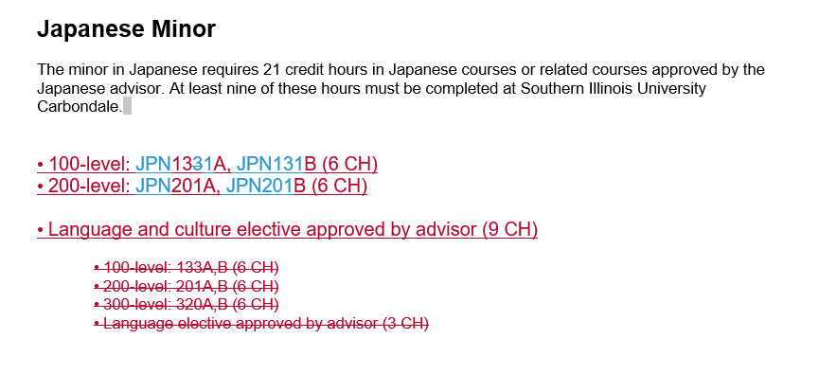
Form 90A and RME
Modify a Minor’s Degree Requirements – Form 90A
Eliminate a Minor – RME Approval

Slide 7
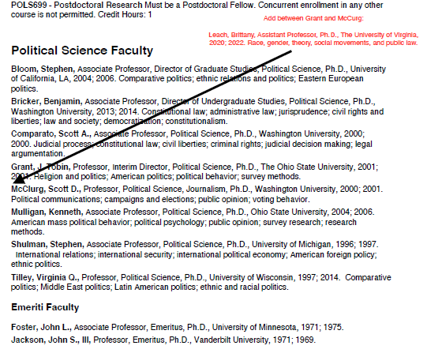
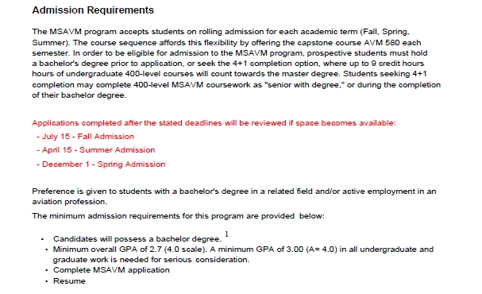
Form 90A and RME
Modify Catalog Copy – Form 90A
Modify Faculty Listing – Form 90A

Slide 8
Form 90A and RME
RME changes should not be included in the same catalog markup as changes that do not require an RME.
The APAP will not process a Form 90A that contains non-approved RME required changes.

Slide 9
Program Description
Form 90As are due to the APAP Office no later than October 1st to appear in the next catalog cycle.
Forms received by October 1, 2024, will be included in the 2025-26 catalog.
Form 90As can be submitted to the APAP office at any time. They do not need to be held for October submission.
APAP and the Registrar are the final approvers on the forms.

Slide 10
Catalog Forms Process
Director Approval
Curricular Committee Approval (if applicable)
Dean Approval
Graduate School (APAP office will obtain signature if needed)
APAP Approval (forms due by October 1st)
Registrar Approval

Slide 11
Program Description (Form 90A)
Specify catalog – Undergraduate or Graduate
Provide College Name and School/Department Name
Specify the degree to be edited
Provide the major/program to be edited

Slide 12
Program Description (Form 90A)
Supporting documents are required – Word or PDF files – and should thoroughly describe the requested changes.
Use the current catalog page and provide legible markup using Adobe editing tools or Word with tracked changes.

Slide 13
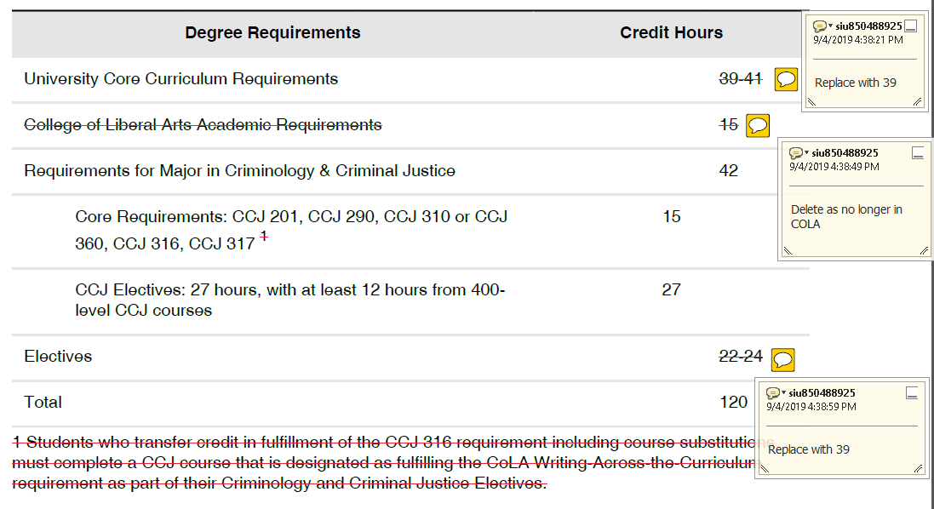
Edits in Adobe
Download pages from catalog and edit using Adobe markup tools

Slide 14
Edits in Word
Create a Word document and use track changes when editing

Slide 15
Signature Lines
Form 90As must contain all school/department and college-level signatures before submission to the APAP Office. APAP staff will gather all additional necessary signatures, including Graduate School dean.
Note: Electronic signatures of academic officer is required. Staff signatures will not be accepted.

Slide 16
Common Errors
Multiple Form 90As received for the same program page in the same catalog cycle with conflicting edits. Submit one Form 90A for all changes to a program page.
When editing the degree requirements table, make sure the credit hours are still mathematically correct.
Make sure requested edits are clear. You know what the intended changes are. Is it clear to your audience?
Where else in the catalog needs changed? Example: program name change.

Slide 17
Course Description (Form 90)

Slide 18
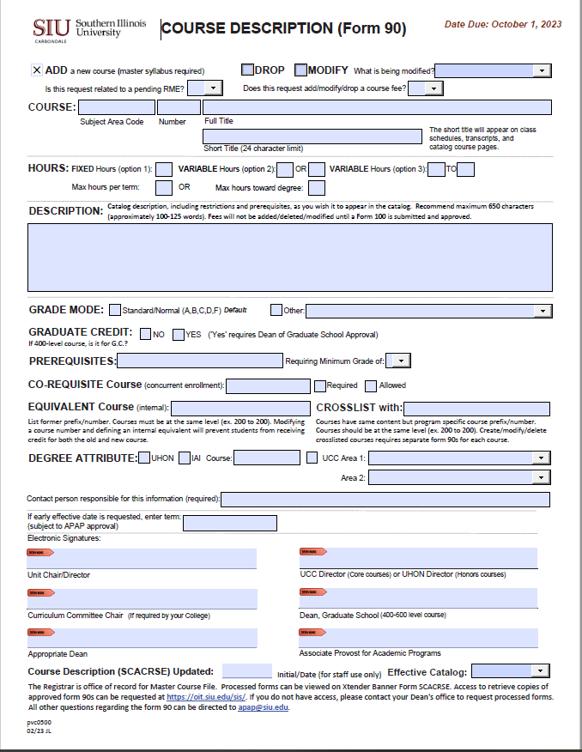
Course Description (Form 90)
The Course Description (Form 90) is used to add, drop, or modify a course.
Modifications include:
Course prefix, number, or title
Hours
Description
Grade mode
Prerequisite, co-requisite, equivalent, or crosslist
Degree attribute

Slide 19
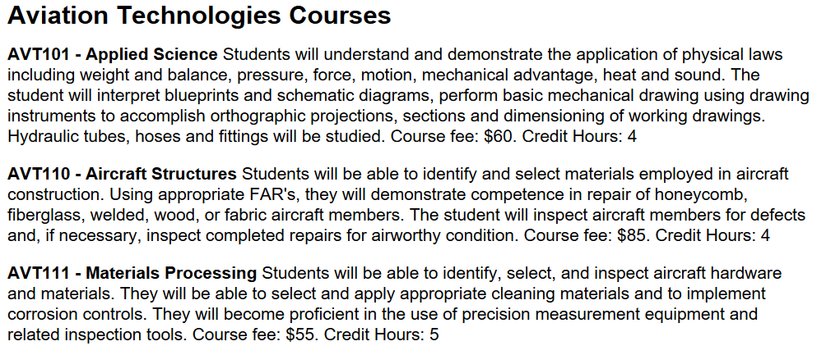
Catalog Course Listings
The “Courses” section of each catalog page is automatically populated from Banner. Any edit for this section requires a Course Description (Form 90).
The Credit Hours automatically populate from Banner into the catalog course description. When completing a Form 90, do not include credit hours in the course description box. Otherwise, it will appear twice.

Slide 20
Course Description (Form 90)
Form 90s that support degree requirement changes are due October 1st :
Form 90s can be submitted to the APAP Office at any time.
Courses can be added at any time and will appear in the catalog for the next cycle
Courses can be dropped at any time. The earliest effective term will the be the next available term. The course will be removed from the catalog in the next cycle.
Courses that are part of degree requirements, UCC, etc. will need to be dropped in the next catalog cycle. A Form 90A will need to be submitted with the Form 90.
APAP and the Registrar are the final approval on these forms.

Slide 21
Catalog Forms Process
Director Approval
Curricular Committee Approval (if applicable)
Dean Approval
Graduate School/UCC/ Honors (APAP office will obtain signature if needed)
APAP Approval (forms due by October 1st)
Registrar Approval

Slide 22
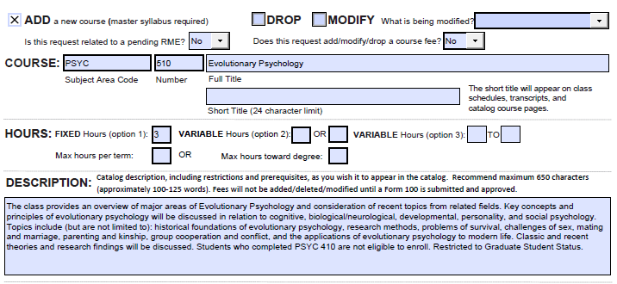
Course Description (Form 90)
Confirm course number availability with the Registrar’s Office. A course number cannot be ‘reused’ for 10 years.
Submit a master syllabus with the Form 90.

Slide 23
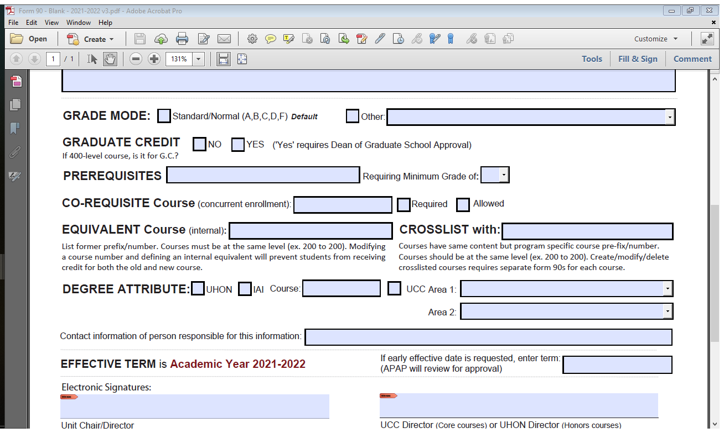
Add a New Course
Options:
C Credit/No Credit
D Letter Grade Deferred (Graduate Only)
I Satisfactory/Unsatisfactory/Incomplete (Undergraduate Only)
P Pass/Fail
R Standard/Normal/PR
U Satisfactory/Unsatisfactory/Deferred (Graduate Only)

Slide 24
Add a New Course
At SIUC, 400-level courses may be for undergraduates and graduates.

Slide 25
Pre-Requisites and Restrictions
Pre-Requisites – Previous course(s) credit required to support current registration. Include the information listed in the Prerequisite box in the description box as well.

Slide 26
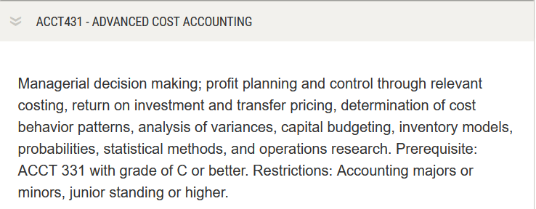
Pre-Requisites and Restrictions: Example
This is what will appear in the Courses listing in the catalog.

Slide 27
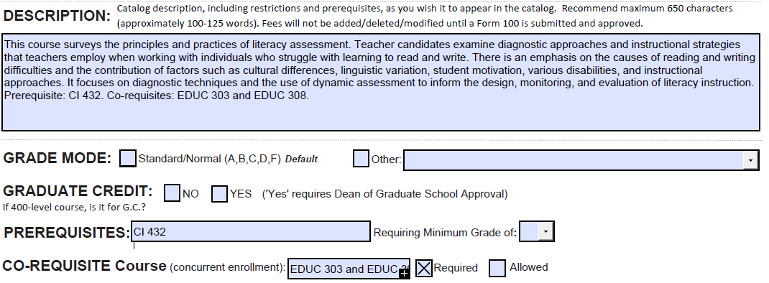
Co-Requisites
Co-Requisites –Course(s) that are required to accompany registration, what was previously referred to as “Concurrent Enrollment”, Include the information listed in the Co-Requisite Course box in the description box as well.

Slide 28
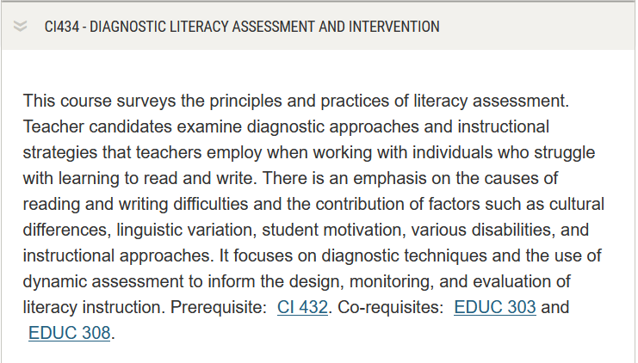
Co-Requisites: Example
This is what will appear in the Courses listing in the catalog.

Slide 29
Equivalent and Crosslisted Courses
EQUIVALENT courses are the former course name/numbers. For example, ITEC 450 and IST 450. A student who has taken IST 450 will not be able to take ITEC 450 for credit.
CROSSLISTED courses meet at the same time and follow the same syllabi but have program specific names/numbers. For example, MHA 510 and MHI 510. Courses must be at the same level and course details must match. A Form 90 cannot be processed until all forms are received.

Slide 30
Degree Attribute
Specify if the course is Honors, IAI, or part of University Core Curriculum.

Slide 31
Signature Lines
Form 90s must contain all school/department and college-level signatures before submission to the APAP Office. APAP staff will gather all additional necessary signatures, including Graduate School dean.
Note: Electronic signature of academic officer is required. Staff signatures will not be accepted.

Slide 32
Drop a Course
Provide course Prefix, Number, and Name
A separate Form 90 is required for other courses that are associate with this course.
Crosslisted course
Co-Requisite course
Pre-Requisite course
A Form 100 is required if the course being dropped has a course specific fee associated to it.
A Form 90A is required if the course being dropped is listed in the catalog copy and/or degree requirements table.
Confer with other programs that use your courses. A Form 90A may be needed from another academic program if they have the course being dropped in their catalog copy and/or degree requirements table.

Slide 33
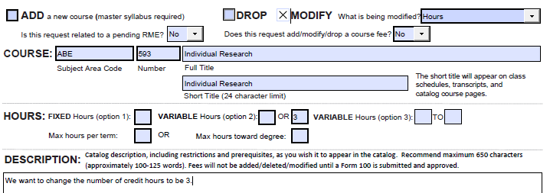
Modify a Course
Provide course Prefix, Number, and Name
Select the most accurate description from the dropdown menu

Slide 34
Modify a Course
A Form 90 is required for any co-requisite or crosslisted course associated with the modified course.
MHI 510
When additional Form 90s are needed due to co-requisite or crosslistings for courses outside your program/school, please contact the appropriate director to advise that Form 90s are necessary. Include a copy of your Form 90 and any supporting documentation for their reference. Your Form 90 cannot be processed until all Form 90s are received.

Slide 35
Modify a Course
When renaming a course – if it is listed on the requirements table or referenced in the front matter of your catalog page, you must submit a Form 90A to rename it.
For example - IST prefix changed to ITEC:
Form 90s submitted to change course names. (Blanket Form 90 appropriate here.)
Form 90A submitted to update catalog page for Information Technology
Additional Form 90As necessary for Electronic Systems Technologies (EST), as IST 209 is listed within their requirements table as an Approved Technical or Career Elective

Slide 36
Common Errors
Missing approval signatures; support staff cannot sign ‘on behalf of’ a director or dean.
Missing master syllabi – required when adding new courses.
Graduate Credit – check “yes” or “no”. This prompts APAP staff to submit form to Graduate School for signature.
Degree Attribute – mark if a course has been approved by UHON or UCC. This prompts APAP staff to submit form for to UCC or Honors for signature.
Co-Requisite, Equivalent, or Crosslisted courses should be listed on the Form 90. Accompanying Form 90s for these courses are required.
Include Prerequisites and Co-Requisites in the description box.
An Equivalent course is a former course. Crosslisted courses are current courses that have the same content.
When defining a prerequisite, EDUC XXX, PHIL XXX = EDUC XXX and PHIL XXX

Slide 37
Common Errors
When DROPPING a course – if it is a pre-requisite for another course XYZ, a Form 90 is needed for course XYZ to remove it as a pre-requisite.
When DROPPING a course – if it is listed on the requirements table or referenced in the front matter of your catalog page, you must submit a Form 90A to remove it.
When renaming a course – if it is listed on the requirements table or referenced in the front matter of your catalog page, you must submit a Form 90A to rename it.
We recommend that you download the forms and fill it out using PDF software. The form is not designed to be filled out within a web browser.
A Form 90 is required to modify a course listing in the catalog. A Form 90A is not needed.
Courses listed in the catalog should be reviewed. Those no longer offered should be eliminated.
Courses on the schedule of classes should be reviewed. Courses that will not be offered should be removed. They can be added back to the schedule with a Form 75.

Slide 38
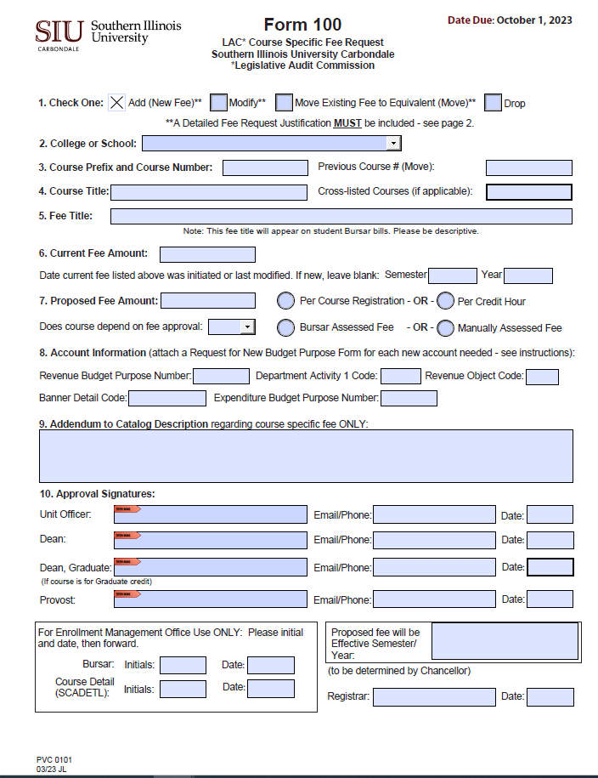
Fee Request (Form 100)
The LAC Course Specific Fee Request (Form 100) is used to request a New fee, Modify an existing fee, Move an existing fee to an equivalent course number, or Drop an existing fee. Completing the form:
Check request type
College responsible for revenue and expenditures
Course Prefix and Course Number
Previous course # if moving fee to an equivalent course
If cross-listed with another course, enter course prefix/number
Course Title (as indicated in catalog)
Course specific fee title (ex. CHEM 120 lab fee) – this will appear on students’ Bursar bill

Slide 39
Fee Request (Form 100)
Completing the form (cont):
Current fee amount (for modifications and moves)
Proposed (requested) fee amount
Fee Moves - use the current fee amount (no fee modifications may be requested if an existing fee is being moved
Select the appropriate radio button for each row (manual billing must be pre-approved)
Account information
If a new revenue and/or expenditure BP is needed, attach a “Request for New Budget Purpose” form
A unique Department Activity 1 (DA1) code can be assigned to track revenue for a specific course
Type the desired addendum to the existing catalog description regarding the Course Specific Fee ONLY (ex: Lab fee $x.xx; Field trip fee $x.xx)

Slide 40
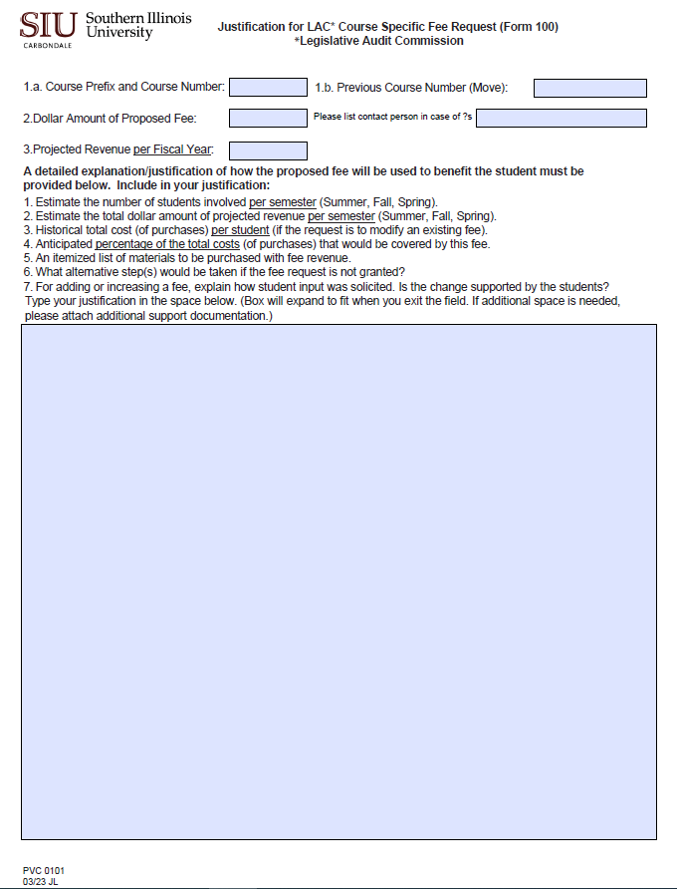
Fee Request (Form 100)
If the request is for a new fee (Add) or modification of an existing fee (Modify), page 2 must be completed.
Note: Evidence of soliciting student input and results must be included (item 7).
Any proposed course fee in the amount of $200+ requires Board of Trustees approval.
The Office of the Bursar will initial and date when their processing is complete. The form will then be forwarded to Transfer Student Services.
The Transfer Student Services office will update the master course file, course detail (SCADETL), and index a copy of the form in Banner.
Original file will be maintained by Transfer Student Services.
Effective date of approved fees is designated by Transfer Student Services.

Slide 41
APAP Office
Associate Provost for Academic Programs
Melissa Laake, Office Administrator
apap@siu.edu
453-7653
Registrar Office
Suzanne Goad, Master Course File, Degree Works, Program Articulation Degree Reviews
sgoad@siu.edu
453-7134
iTransfer (https://itransfer.org/) Source of IAI numbers as well as information on transfer of coursework in the State of Illinois
Additional tutorials related to catalog processes and program reviews at SIUC (https://pvcaa.siu.edu/associate-academic-programs/tutorials.php). Includes guidelines for developing a master syllabus.
Office of the Registrar: registrar@siu.edu

Slide 42
THANK YOU!

